Slide 1
Logical Agents
Notes:
NN 1
Elena Marchiori

Slide 2
Outline
Introduction
Knowledge Based agents
Notes:
NN 1
Elena Marchiori

Slide 3
Introduction
Humans know things; and what they know helps them do things.
These statements make strong claims about how the intelligence of humans is achieved
  not by purely reflex mechanisms
  but by processes of reasoning that operate on internal representations of knowledge.
In AI, this approach to intelligence is embodied in knowledge-based agents.

Slide 4
Concepts of Artificial Intelligence
1) The representation of knowledge and
2) The reasoning processes that bring knowledge to life
Knowledge and reasoning are important for artificial agents

Slide 5
Limitation of other agents
A reflex agent – could find its way from source to destination
  (finding solution by dumb luck as it has knowledge on action outcomes only)

Slide 6
Limitation of other agents
The knowledge of problem solving agent is specific and inflexible
  Ex1: a chess program can calculate the legal moves of its king
  But does not know that no piece can be on two different squares at the same time
  Ex2: 8-puzzle – “knowledge of what the actions do” is hidden inside the domain-specific code of the RESULT function.
  It can be used to predict the outcome of actions
  but does not deduce that two tiles cannot occupy the same space

Slide 7
Limitation of other agents
Limitation of problem solving agent
The atomic representations used by problem-solving agents are also very limiting.
  In a partially observable environment, an agent's only choice for representing what it knows about the current state is to list all possible concrete states
a hopeless prospect in large environments.

Slide 8
Idea ? (Knowledge based agent)
Idea: representing states as assignments of values to variables
  Enables agent to work in a domain-independent way and
  allows for more efficient algorithms.
So using this, we develop logic as a general class of representations to support knowledge-based agents.

Slide 9
Idea? Knowledge based agent
Knowledge based agent takes knowledge expressed in general forms by combining and recombining the information
Can deal with partially observable environments
  Can combine general knowledge with current percepts
  to infer hidden aspects of the current state prior to selecting actions
Hence Knowledge and reasoning also play a crucial role in dealing with partially observable environments.

Slide 10
Idea? Knowledge
Knowledge
Ex: a physician diagnoses a patient—that is, infers a disease state that is not directly observable—prior to choosing a treatment.
Some of the knowledge that the physician uses
  rules learned from textbooks and teachers, and
  some in the form of patterns of association that the physician may not be able to consciously describe.
  If its inside the physician’s head, it counts as knowledge.

Slide 11
Idea? Reasoning
Reasoning
Understanding natural language also requires inferring hidden state, namely, the intention of the speaker.
  Ex1: “John threw the brick through the window and broke it,”
  we know “it” refers to the window.
  Ex2: “John saw the diamond through the window and coveted it,”
  we know “it” refers to the diamond and not the window
we reason, perhaps unconsciously, with our knowledge of relative value.

Slide 12
Idea? Reasoning
Reasoning
Reasoning allows us to cope with the virtually infinite variety of utterances using a finite store of commonsense knowledge.
Problem-solving agents have difficulty with this kind of ambiguity because their representation of contingency problems is inherently exponential.

Slide 13
So why we learn KBA?
Flexibility
They are able to accept new tasks in the form of explicitly described goals
they can achieve competence quickly
  by being told or
  learning new knowledge about the environment, and
they can adapt to changes in the environment by updating the relevant knowledge.

Slide 14
Syllabus ahead

Slide 15
Part III
Logic will be the primary vehicle for representing knowledge (throughout Part III of the book)
The knowledge of logical agents is always definite—each proposition is either true or false in the world

Slide 16
Chapter 7 and Chapter 8
Defines a simple logic called propositional logic.
Propositional logic serves to illustrate all the basic concepts of logic.
There is also a well-developed technology for reasoning in propositional logic(in sections 7.5 and 7.6)
Section 7.7 combines the concept of logical agents with the technology of propositional logic to build some simple agents for the wumpus world
Shortcomings in propositional logic
    much less expressive than first-order logic (Chapter 8)
Motivated the development of more powerful logics in subsequent chapters

Slide 17
Limitations of Logic
Logic has the simple representation for knowledge-based agents
But logic has severe limitations.
  Clearly, a large portion of the reasoning carried out by humans and other agents in partially observable environments depends on handling knowledge that is uncertain.
  Logic cannot represent this uncertainty well
so in Part V probability is covered.
In Part VI and Part VII other representations including some based on continuous mathematics such as mixtures of Gaussians, neural networks, and other representations are covered.

Slide 18
Knowledge based Agents

Slide 19
Knowledge bases
Knowledge base
The central component of a knowledge-based agent is its knowledge base, or KB.
A knowledge base is a set of sentences.
  (Here "sentence“ is related but not identical to the sentences of English and other natural languages)
Each sentence is expressed in a language called a knowledge representation language
sentence represents some assertion about the world.
  Sometimes we dignify a sentence with the name axiom, when the sentence is taken as given without being derived from other sentences

Slide 20
TELL and ASK Operations
TELL - a way to add new sentences to the knowledge base
ASK - a way to query what is known.
Inference
Both operations may involve inference-that is, deriving new sentences from old.
  Inference must obey the requirement that when one ASKs a question of the knowledge base,
  the answer should follow from what has been told (or TELLed) to the knowledge base previously.
Note: The word “follow” will be clarified later in the chapter

Slide 21

Knowledge bases
Knowledge base = set of sentences in a formal language
Declarative approach to building an agent (or other system):
  Tell it - what it needs to know
Agents can be viewed at the knowledge level
  i.e., what they know, regardless of how they are implemented
Or at the implementation level
  i.e., data structures in KB and algorithms that manipulate them
  Then it can Ask itself what to do - answers should follow from the KB

Slide 22
A generic knowledge-based agent
A knowledge-based agent program.
  Like all other agents, it takes a percept as input and returns an action.
The agent maintains a knowledge base, KB
KB may initially contain some background knowledge.

Slide 23
A generic knowledge-based agent
Each time the agent program is called, it does three things.
First, it TELLs the knowledge base what it perceives.
Second, it ASKs the knowledge base what action it should perform.
  In the process of answering this query, extensive reasoning may be done about the current state of the world, about the outcomes of possible action sequences, and so on.
Third, the agent program TELLs the knowledge base which action was chosen, and the agent executes the action.

Slide 24

A simple knowledge-based agent
The agent must be able to:
  Represent states, actions, etc.
  Incorporate new percepts
  Update internal representations of the world
  Deduce hidden properties of the world
  Deduce appropriate actions

Slide 25
A simple knowledge-based agent
Given a percept, the agent adds the percept to its knowledge base
asks the knowledge base for the best action, and
tells the knowledge base that it has in fact taken that action.

Slide 26
A simple knowledge-based agent
The details of the representation language are hidden inside three functions that implement the interface between the sensors and actuators on one side and the core representation and reasoning system on the other.
MAKE-PERCEPT-SENTENCE constructs a sentence asserting that the agent perceived the given percept at the given time.
MAKE-ACTION-QUERY constructs a sentence that asks what action should be done at the current time.
MAKE-ACTION-SENTENCE constructs a sentence asserting that the chosen action was executed.
The details of the inference mechanisms are hidden inside TELL and ASK (will be discussed later)

Slide 27
How to build KBA?
Declarative Approach
A knowledge based agent can be built simply by TELLing it what it needs to know.
Starting with an empty knowledge base, the agent designer can TELL sentences one by one until the agent knows how to operate in its environment. This is called the declarative approach to system building.
Procedural approach
In contrast, the procedural approach encodes desired behaviors directly as program code.
a successful agent often combines both declarative and procedural elements in its design, and
declarative knowledge can often be compiled into more efficient procedural code.

Slide 28
Wumpus World
To illustrate important points about intelligence

Slide 29
Wumpus World
An environment is described in which knowledge-based agents can work.
The wumpus world is a cave consisting of rooms connected by passageways.
Lurking somewhere in the cave is the terrible wumpus, a beast that eats anyone who enters its room.
The wumpus can be shot by an agent, but the agent has only one arrow.
Some rooms contain bottomless pits that will trap anyone who wanders into these rooms (except for the wumpus, which is too big to fall in).
The only mitigating feature of this bleak environment is the possibility of finding a heap of gold.

Slide 30
Wumpus World PEAS description

Slide 31

Wumpus World PEAS description
Performance measure
  gold +1000, death -1000
  -1 per step, -10 for using the arrow
Environment
  A 4 x 4 grid of rooms.
  The agent always starts in the square
  labeled [1, 1], facing to the right
The locations of the gold and the wumpus are chosen randomly, with a uniform distribution, from the squares other than the start square.
In addition, each square other than the start can be a pit, with probability 0.2

Slide 32
Wumpus World PEAS description
Actuators: turn left by 90⁰ , turn right by 90⁰, Forward, Grab, Release, Shoot
Grab - The action Grab can be used to pick up the gold if it is in the same square as the agent.
  Release - Releasing drops the gold in same square
Shoot - The action Shoot can be used to fire an arrow in a straight line in the direction the agent is facing.
  The arrow continues until it either hits (and hence kills) the wumpus or hits a wall.
  Shooting kills wumpus if the agent is facing it
  The agent has only one arrow, so only the first Shoot action has any effect.
Climb - the action Climb can be used to climb out of the cave, but only from square [1 ,1].
Forward - If an agent tries to move forward and bumps into a wall, then the agent does not move.

Slide 33
Wumpus World PEAS description
Sensors: Stench, Breeze, Glitter, Bump, Scream
The agent has five sensors, each of which gives a single bit of information:
Stench - In the square containing the wumpus and in the directly (not diagonally) adjacent squares, the agent will perceive a Stench.
Breeze - In the squares directly adjacent to a pit, the agent will perceive a Breeze.
Glitter - In the square where the gold is, the agent will perceive a Glitter.
Bump - When an agent walks into a wall, it will perceive a Bump.
Scream - When the wumpus is killed, it emits a woeful Scream that can be perceived anywhere in the cave.
The percepts will be given to the agent program in the form of a list of five symbols
Ex: if there is a stench and a breeze, but no glitter, bump, or scream the agent program will get [Stench, Breeze, None, None, None]

Slide 34
Wumpus world characterization
Partially observable -
  some aspects of the state are not directly perceivable: the agent's location, the wumpus's state of health, and the availability of an arrow.
  As for the locations of the pits and the wumpus: we could treat them as unobserved parts of the state that happen to be immutable
Sequential - because rewards may come only after many actions are taken.
Transition model –
  Either, the transition model for the environment is completely known;
  or the transition model is unknown because the agent doesn't know which Forward actions are fatal
    in which case, discovering the locations of pits and wumpus completes the agent's knowledge of the transition model.

Slide 35
Wumpus world characterization - Summary
Fully Observable No – only local perception
Deterministic Yes – outcomes exactly specified
Sequential – sequential at the level of actions
Static Yes – Wumpus and Pits do not move
Discrete Yes
Single-agent? Yes – Wumpus is essentially a natural feature not another agent (The wumpus doesn't move, fortunately)

Slide 36
Wumpus world
For an agent in the environment, the main challenge is its initial ignorance of the configuration of the environment;
  overcoming this ignorance require logical reasoning
In most instances of the wumpus world, it is possible for the agent to retrieve the gold safely.
Occasionally, the agent must choose between going home empty-handed and risking death to find the gold.
About 21% of the environments are unfair, because the gold is in a pit or surrounded by pits.

Slide 37
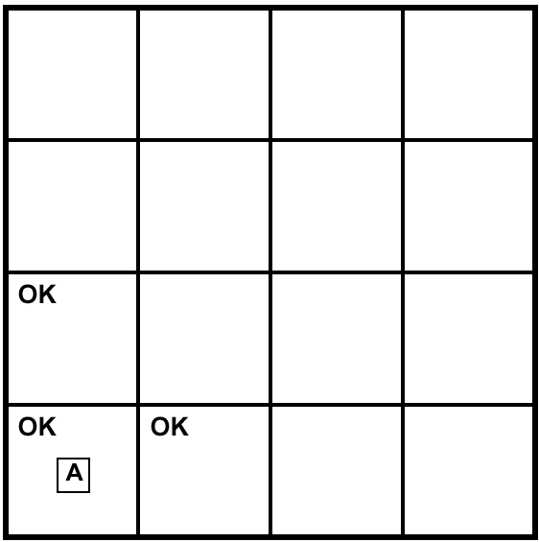
Exploring a Wumpus world
We use an informal knowledge representation language consisting of writing down symbols in a grid
Directly observed:
S: stench
B: breeze
G: glitter
A: agent
Inferred (mostly):
OK: safe square
P: pit
W: wumpus
V: visited

Slide 38
Problem statement -1
Explore the wumpus world problem with following percepts:
  No percept at [1,1]
  Breeze at [2,1]
  Stench at [1,2]
  BGS at [2,3]
Show all possible inferences for pit and Wumpus. There can be several pits but atmost one Wumpus only.

Slide 39
Wumpus world
Initial KB - The agent's initial knowledge base contains the rules of the environment (described previously).
In particular it knows that it is in [1,1] and that [1, 1] is a safe square;
we denote that with an “A” and "OK," respectively, in square [1,1].
The first percept is [None, None, None, None, None], from which the agent can conclude that its neighboring squares, [1 ,2] and [2, 1 ], are free of dangers-they are OK.
Figure (a) shows the agent's state of knowledge at this point.

Slide 40
Wumpus world
A typical wumpus world. The agent is in the bottom left corner, facing right

Slide 41
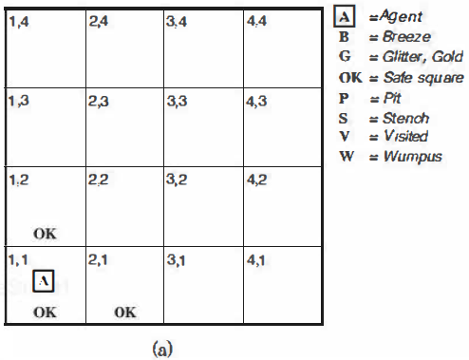
Wumpus world
(a) The initial situation, after percept [None, None, None, None, None]

Slide 42
Wumpus world
A cautious agent will move only into a square that it knows to be OK.
Let us suppose the agent decides to move forward to [2,1].
The agent perceives a breeze (denoted by "B'') in [2, 1 ], so there must be a pit in a neighboring square.
The pit cannot be in [1, 1], by the rules of the game
so there must be a pit in [2,2] or [3,1] or both.
The notation "P?" in Figure 7.3(b) indicates a possible pit in those squares.
At this point, there is only one known square that is OK and that has not yet been visited.
So the prudent agent will tum around, go back to [1 ,1], and then proceed to [1 ,2].

Slide 43
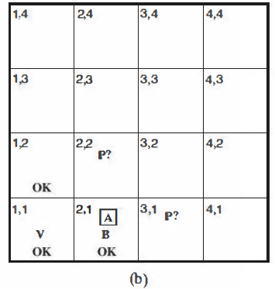
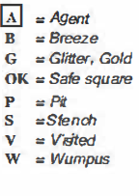
Wumpus world
(b) After one move, with percept [None, Breeze, None, None, None]

Slide 44
Wumpus world
The agent perceives a stench in [1 ,2], resulting in the state of knowledge shown in Figure (c).
The stench in [1,2] means that there must be a wumpus nearby.
But the wumpus cannot be in [1,1], by the rules of the game, and it cannot be in [2,2] (or the agent would have detected a stench when it was in [2,1]).
Therefore, the agent can infer that the wumpus is in [1 ,3]. The notation “W!” indicates this inference.
Moreover, the lack of a breeze in [1,2] implies that there is no pit in [2,2].
Yet the agent has already inferred that there must be a pit in either [2,2] or [3,1], so this means it must be in [3, 1].
This is a fairly difficult inference, because it combines knowledge gained at different times in different places and relies on the lack of a percept to make one crucial step

Slide 45
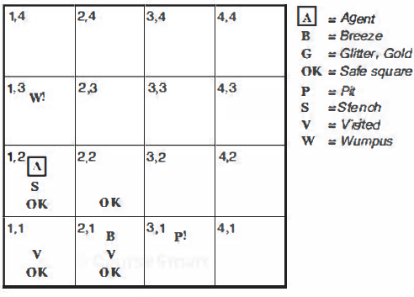
Wumpus world
(c)
(c) After the third move, with percept [Stench, None, None, None, None].

Slide 46
Wumpus world
The agent has now proved to itself that there is neither a pit nor a wumpus in [2,2],
so it is OK to move there. We do not show the agent's state of knowledge at [2,2];
we just assume that the agent turns and moves to [2,3], giving us Figure (d).
In [2,3], the agent detects a glitter, so it should grab the gold and then return home

Slide 47
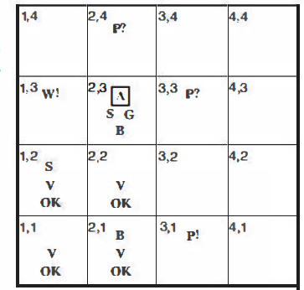
Wumpus world
(d)
(d) After the fifth move, with percept [Stench, Breeze, Glitter, None, None]

Slide 48
Wumpus world
The agent has found the gold and won.
Do we want to kill the wumpus? (hint: look at the Performance measure)
Performance measure
  gold +1000, death -1000
  -1 per step, -10 for using the arrow

Slide 49

Problem statement - 2
Explore the wumpus world problem with following percepts:
  No percept at [1,1]
  Breeze at [1, 2]
  Stench at [2, 1]
  No percept at [2,2] (choose [3,2])
  BGS at [3, 2]
However, the agent should advance to [1,2] now from [1,1] instead of [2,1].
Show all possible inferences for pit and Wumpus. There can be several pits but atmost one Wumpus only.

Slide 50
Solution - Exploring a wumpus world

Slide 51

Exploring a wumpus world

Slide 52

Exploring a wumpus world

Slide 53

Exploring a wumpus world

Slide 54

Exploring a wumpus world

Slide 55

Exploring a wumpus world

Slide 56

Exploring a wumpus world

Slide 57

Exploring a wumpus world

Slide 58
Wumpus world
logical reasoning
In each case for which the agent draws a conclusion from the available information, conclusion is guaranteed to be correct if the available information is correct.
This is a fundamental property of logical reasoning.
Next, describe how to build logical agents that can represent information and draw conclusions

Slide 59
Logic in General

Slide 60
Logic in general
Logics are formal languages for representing information such that conclusions can be drawn
Syntax defines the sentences in the language
Semantics define the "meaning" of sentences
  i.e., define truth of a sentence in a world
We can also think of logic as an “algebra” for manipulating only two values: true (T) and false (F)

Slide 61
Logic in general
We begin with the fundamental concepts of logical representation and reasoning.
  Without using any propositional or predicate logic
  instead using the ordinary arithmetic.
It is known that
  knowledge base consist of sentences.
Syntax:
These sentences are expressed according to the syntax of the representation language, which specifies all the sentences that are well formed.

Slide 62
Logic in general
Syntax in ordinary arithmetic:
"x + y = 4" is a well-formed sentence, whereas "x4y+ =" is not.

Slide 63
Logic in general
Semantics
A logic must also define the semantics or meaning of sentences.
The semantics defines the truth of each sentence with respect to each possible world.
Example:
  The semantics for arithmetic specifies that the sentence "x + y = 4" is
    true in a world where x is 2 and y is 2
    but false in a world where x is 1 and y is 1 .
In standard logic, every sentence must be either true or false in each possible world (nothing “in between”).

Slide 64
Models
To be precise, we use the term model in place of "possible world."
"possible world“ vs. model
  possible worlds might be thought of as (potentially) real environments that the agent might or might not be in
  models are mathematical abstractions, each of which simply fixes the truth or falsehood of every relevant sentence.
Note: Model (or interpretation) = a possible world w + a “dictionary” telling how the different parts of the statement are to be understood in w.

Slide 65
Models
Example:
  Informally,
    we may think of a possible world as, for example, having x men and y women sitting at a table playing bridge
    the sentence x + y = 4 is true when there are four people in total.
  Formally,
    the possible models are just all possible assignments of real numbers to the variables x and y.
    Each such assignment fixes the truth of any sentence of arithmetic whose variables are x and y.

Slide 66
Models
Let α – sentence and m - model
m is a model of α or m satisfies α:
If a sentence α is true in model m, we say that m satisfies α or sometimes m is a model of α .
M (α ) : set of all models of α
We use the notation M (α ) to mean the set of all models of α

Slide 67
Logical Entailment
Let α – sentence and m - model
Logical entailment (meaning: logical consequence, deduction or implication)
Now that we have a notion of truth, we are ready to talk about logical reasoning.
This involves the relation of logical entailment between sentences
  the idea that a sentence follows logically from another sentence.
The formal definition of entailment:
α ╞ β if and only if, in every model in which α is true, β is also true.
In mathematical notation, we write α ╞ β to mean that the sentence α entails the sentence β

Slide 68
Logical Entailment
Alternative meaning:
α ╞ β means that “if α is true, then β must also be true”.
For worlds, this is the same thing as α ╞ β iff M(α) ⊆ M(β).
If α ╞ β, then α is a stronger assertion than β
(Informally, the truth of β is “contained” in the truth of α )
Ex:
The relation of entailment is familiar from arithmetic;
the sentence x + y =4 entails the sentence 4=x + y.
Obviously, in any model where x + y =4—such as the model in which x is 2 and y is 2—it is the case that 4=x + y.

Slide 69

Models
Logicians typically think in terms of models, which are formally structured worlds with respect to which truth can be evaluated
We say m is a model of a sentence α if α is true in m
M(α) is the set of all models of α
Then KB ╞ α iff M(KB) ⊆ M(α)
  Ex:
  KB = Giants won and Reds won
  α = Giants won
Knowledge base KB entails a sentence α iff α is true in all worlds where KB is true

Slide 70
Applying entailment to Wumpus World
A knowledge base can be considered a statement
So we can consider a knowledge base entailing a sentence.
We can apply the analysis to the wumpus-world reasoning example
P entails Q, written P |= Q, means that whenever P is True, so is Q. In other words, all models of P are also models of Q.

Slide 71

Wumpus models
Consider situation after detecting nothing in [1,1], moving right, breeze in [2,1]
Consider possible models for KB assuming only pit positions
These percepts, combined with the agent’s knowledge of the rules of the wumpus world constitute the KB
In our agent viewpoint, possible world = possible state of the environment.
3 Boolean choices ⇒ 8 possible models ([1,2], [2,2] and [3,1])

Slide 72
Wumpus models
M (KB) = ?
After agent A has walked into [2, 1] and perceived only the Breeze
M (KB) consists of all the worlds such that
  there is Breeze in [2, 1], and
  all the possible Pit placements around it, according to his background knowledge β
  but the other squares of the worlds are not drawn, because agent A does not know anything more than about them (yet).
Here KB is considered to be the combined statement “β and α1 and α2. . . and α t” where αi are the individual statements that have been added into KB using Tell until now.

Slide 73

Wumpus models
In our agent viewpoint, possible world = possible state of the environment.
agent is interested in whether the adjacent squares [1,2], [2,2], and [3,1]
contain pits.
Each of the three squares might or might not contain a pit
so there are 2³ =8 possible models as shown above.
3 Boolean choices ⇒ 8 possible models ([1,2], [2,2] and [3,1])

Slide 74
Possible models for the presence of pits in squares [1 ,2], [2,2], and [3,1] : 8 Models
Models are assignments
of true and false to the sentences "there is a pit in [1,2]“
"there is a pit in [2,2]“ etc.

Slide 75
Entailment in Wumpus Worlds
The KB can be thought of as a set of sentences or as a single sentence that asserts all the individual sentences.
When is KB false?
The KB is false in models that contradict what the agent knows
Example: KB is false in any model in which [1,2] contains a pit, because there is no breeze in [1,1].
When is KB true?
There are three models in which the KB is true
These are shown as a subset of the models
Mark the models of α 1 and α 2 for the above KB
Consider two possible conclusions:
α 1 = “There is no pit in [1,2].”
α 2 = “There is no pit in [2,2].”

Slide 76
Eight Models
P_{1,2} | P_{2,2} | P_{3,1} | _{KB} | α₁
False | False | False | False | True
False | False | True | True | True
False | True | False | True | True
False | True | True | True | True
True | False | False | False | False
True | False | True | False | False
True | True | False | False | False
True | True | True | False | False

Slide 77

The KB corresponding to the observations of nothing in [1,1] and a breeze in [2,1] is shown by the solid line

Slide 78
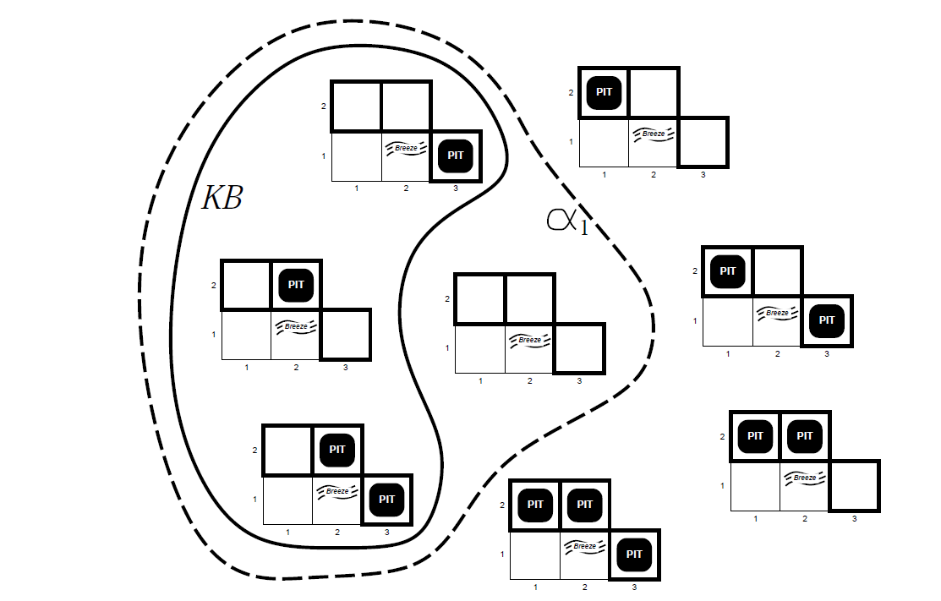

Dotted line shows models of α 1 (no pit in [1 ,2])
KB entails α1 : KB ╞ α1

Slide 79
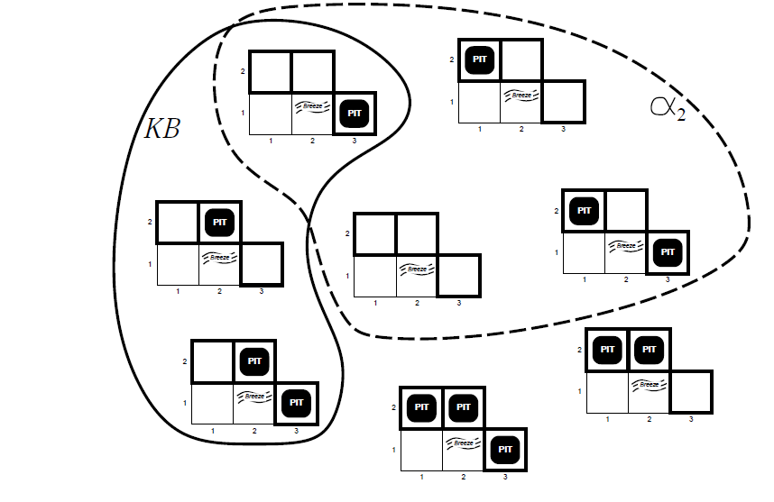
Dotted line shows models of α 2 (no pit in [2,2])
KB does not entail α2

Slide 80
Wumpus models
Consider two possible conclusions:
α1 = “There is no pit in [1,2].”
α2 = “There is no pit in [2,2].”
KB entails α 1 : KB ╞ α1
By inspection, we see the following:
in every model in which KB is true, α 1 is also true.
Hence, KB ╞ α 1: there is no pit in [1,2].
KB does not entail α2
in some models in which KB is true, α2 is false.
Hence, KB does not entail α2 : the agent cannot conclude that there is no pit in [2,2]. (Nor can it conclude that there is a pit in [2,2].

Slide 81
Logical Inference

Slide 82
Inference
Given some sentences how do we get to new sentences?
Inference!

Slide 83
Logical inference
The definition of entailment can also be applied to derive conclusions that is, to carry out logical inference.
MODEL CHECKING
The marking figures of α1 and α2 illustrate the inference algorithm called model checking
because it enumerates all possible models to check that α is true in all models in which KB is true, that is, M(KB) ⊆ M(α)

Slide 84
Logical inference
Entailment and inference:
Think of the set of all consequences of KB as a haystack and of α as a needle.
Entailment is like the needle being in the haystack;
Inference is like finding it.
" α is derived from KB by i " or “ i derives α from KB"
If an inference algorithm i can derive (or infer) α from KB, denote as KB ├_{i} α which means that " α is derived from KB by i " or “ i derives α from KB"

Slide 85
Properties of Inference Algorithm - informal
Soundness: (truth preserving) i is sound if it derives only sentences α that are entailed by KB
Completeness: i is complete if it derives all sentences α that are entailed by KB.
Logic:
  Has a sound and complete inference procedure
  Which will answer any question whose answer follows from what is known by the KB.

Slide 86
Properties of Inference Algorithm - Formal
1) Soundness: (i must not lie: it should not find non existent needles)
An inference algorithm that derives only entailed sentences is sound
i is sound if whenever KB ├_{i} α, it is also true that KB╞ α.
2) Completeness: (opposite to Soundness property: everything which is true should also be derivable by i)
i is complete if whenever KB╞ α, it is also true that KB ├_{i} α

Slide 87
Inference
Simplest inference method is model-based inference
  enumerate all possible models
  check to see if a proposed sentence is true in every KB
  sound, complete
Hence model checking is a sound procedure
Note: Model checking works if the space of models is finite—for example, in wumpus worlds of fixed size.
For arithmetic, on the other hand, the space of models is infinite: even if we restrict ourselves to the integers, there are infinitely many pairs of values for x and y in the sentence x + y = 4

Slide 88
Inference
For haystacks, which are finite in extent, a systematic examination can always decide whether the needle is in the haystack.
Note: For many knowledge bases, however, the haystack of consequences is infinite, and completeness becomes an important issue.
Recall DFS is not complete due to infinite search space

Slide 89
Representation vs. World
Sentence vs. Reasoning
Sentences are physical configurations of the agent
Reasoning is a process of constructing new physical configurations from old ones.
Logical reasoning should ensure that the new configurations represent aspects of the world that actually follow from the aspects that the old configurations represent.

Slide 90
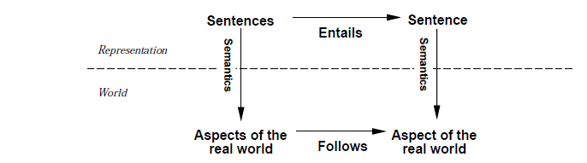
Representation vs. World

Slide 91
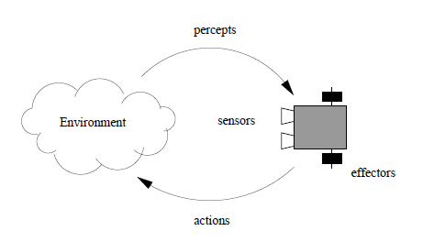
Agent

Slide 92
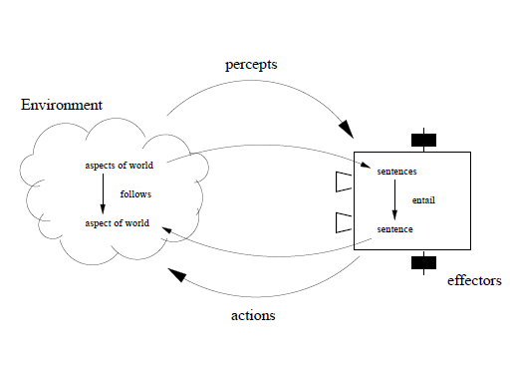
Knowledge based Agent

Slide 93
Grounding
We must also be aware of the issue of grounding: the connection between our KB and the real world.
Grounding: the connection between logical reasoning processes and the real environment in which the agent exists.
In particular, how do we know that KB is true in the real world?
  A simple answer is that the agent's sensors create the connection.
  For example, our wumpus-world agent has a smell sensor.
  The agent program creates a suitable sentence whenever there is a smell.
  Then, whenever that sentence is in the knowledge base, it is true in the real world.
  Thus, the meaning and truth of percept sentences are defined by the processes of sensing and sentence construction that produce them.

